Slide 1
Machine Learning
Layer Activation as Matrix Product

Slide 2
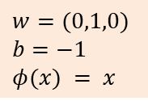
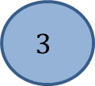
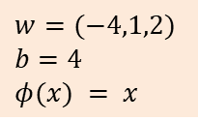
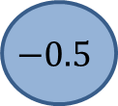
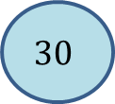
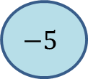
Note the Matrix view: Features are rows!
Input X
Array of shape (2,3)
$$w=(−4,1,2)$$
$$b=4$$
$$φ(x) = x$$
$$30$$
20
$$−5$$
Dense
Layer
$$3$$
2
$$−0.5$$
$$w=(0,1,0)$$
$$b=−1$$
$$φ(x) = x$$

Slide 3
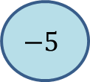
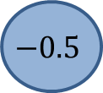
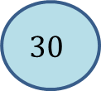
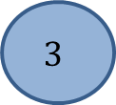

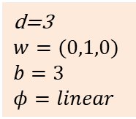
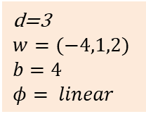
Rotate the feature matrix, just to draw the layer
$$30$$
$$3$$
d=3
$$w=(−4,1,2)$$
$$b=4$$
$$φ= linear$$
20
2
d=3
$$w=(0,1,0)$$
$$b=3$$
$$φ=linear$$
$$−5$$
$$−0.5$$
$\left(\begin{matrix}−106 & 23 \\ −7 & 5\end{matrix}\right)$

Slide 4

Dense Layer as Matrix-Multiplication (ignore Activation for a moment)
$$X= \left(\begin{matrix}30 & 20 & −5 & 1 \\ 3 & 2 & −0.5 & 1\end{matrix}\right), X∈ ℝ^{n×(d+1)}$$
$W = \left(\begin{matrix}−4 & 0 \\ 1 & 1 \\ 2 & 0 \\ 4 & 3\end{matrix}\right), W∈ ℝ^{\left(d+1\right)×l}$
$X⋅W= \left(\begin{matrix}30 & 20 & −5 & 1 \\ 3 & 2 & −0.5 & 1\end{matrix}\right)⋅$ $\left(\begin{matrix}−4 & 0 \\ 1 & 1 \\ 2 & 0 \\ 4 & 3\end{matrix}\right)$ = $\left(\begin{matrix}−106 & 23 \\ −7 & 5\end{matrix}\right)$

